Slide 1
LIFE PROCESSES - NUTRITION

Slide 2
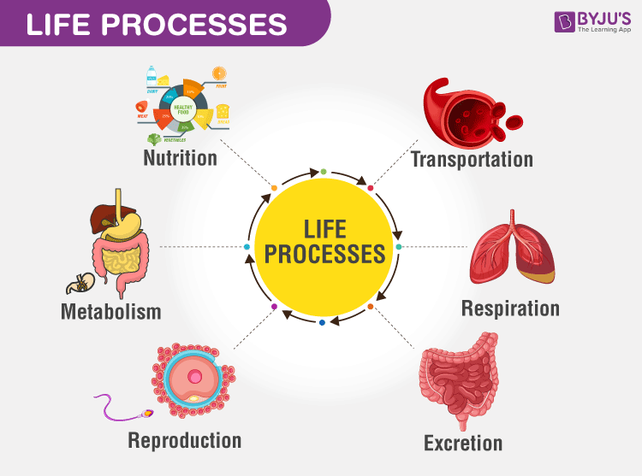
LIFE PROCESSES
All the processes which together perform the maintenance job of the body and are essential for sustaining life are called LIFE PROCESSES.
METABOLISM – Sum total of the various biochemical reactions occurring in living organisms.

Slide 3
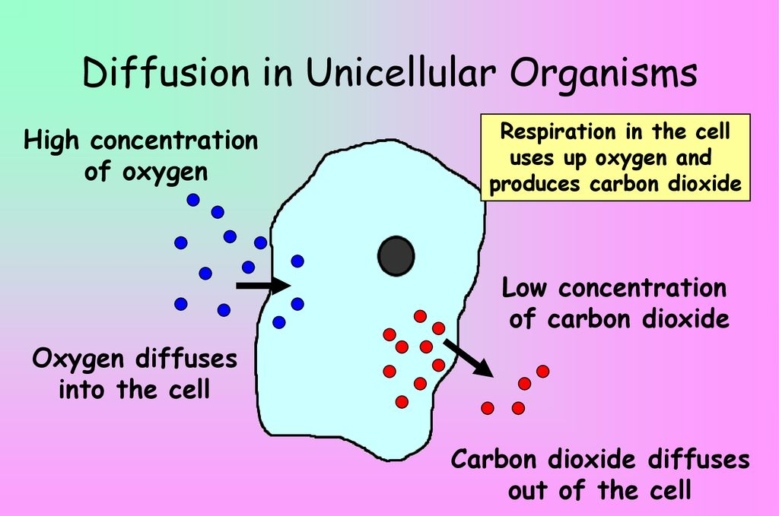
In unicellular organisms, specific organs for taking in food, gaseous exchange, expelling out of waste products and internal transport are not present because the entire surface of the organisms is in contact with the environment and these processes occur by diffusion.

Slide 4
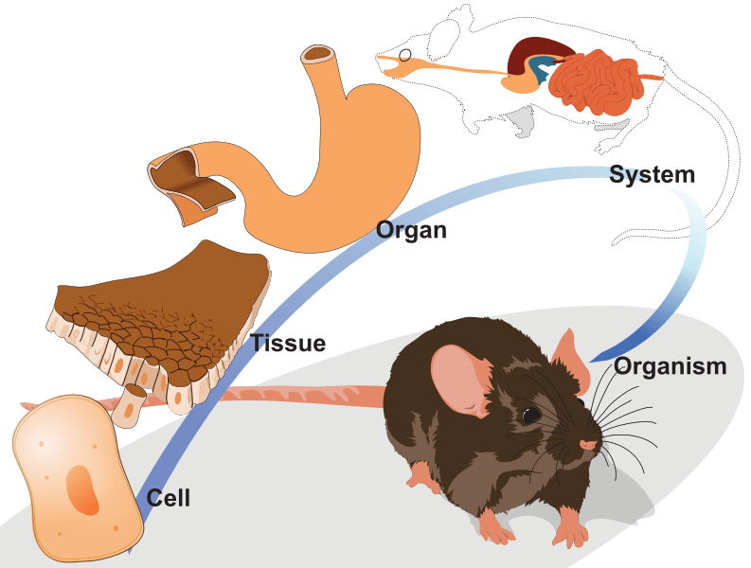
In complex multicellular organisms, all the body cells are not exposed to external environment. Therefore, simple diffusion will not meet the requirements of all the cells. In these organisms, specialised organs/organ systems carry out various life processes.

Slide 5
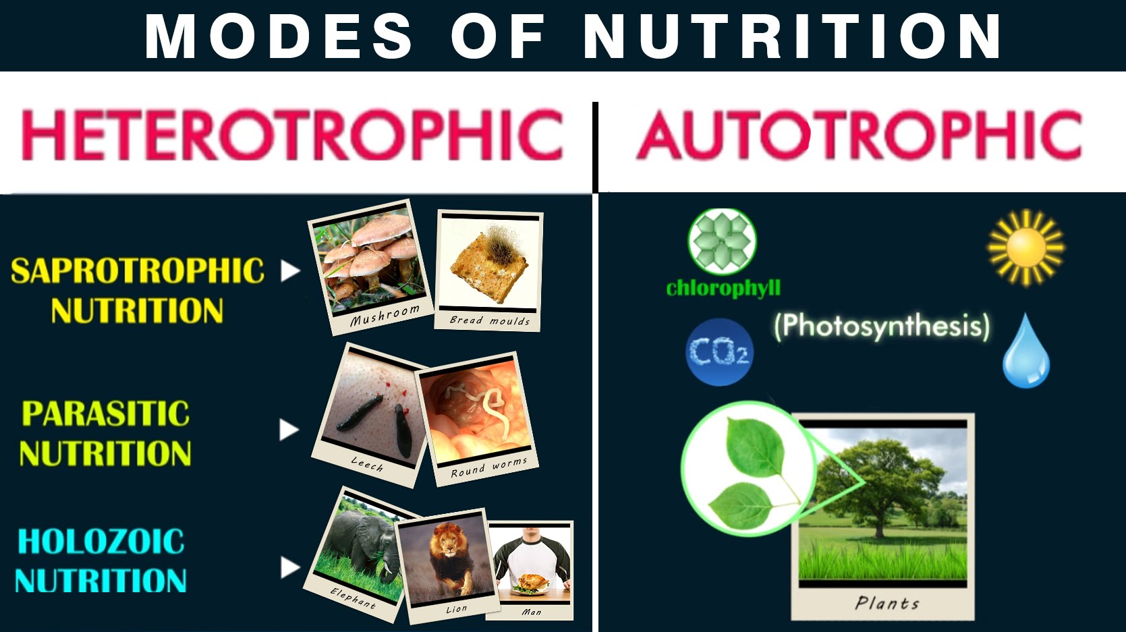
NUTRITION
Process by which living organisms procure nutrients or synthesize them and change them into simple absorbable form by a series of biochemical processes.

Slide 6
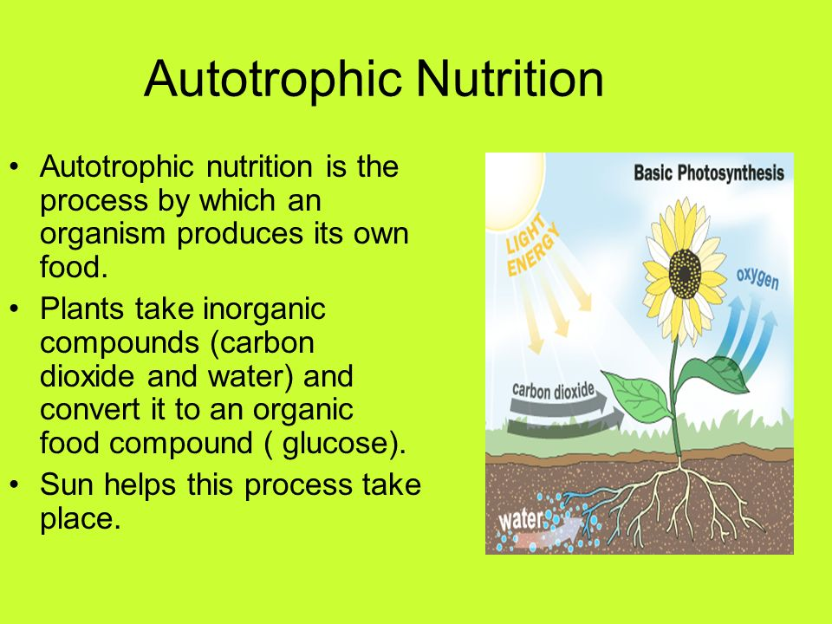

Slide 7
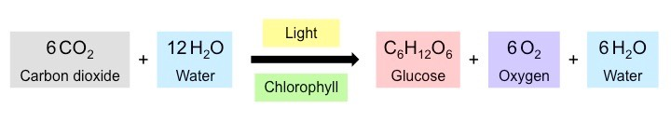
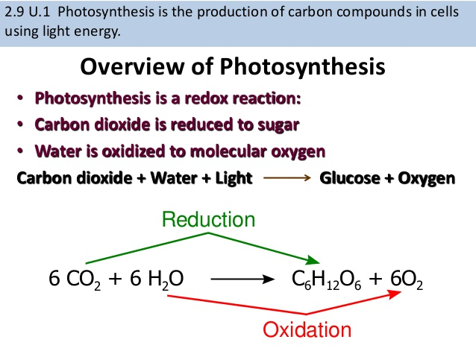
PHOTOSYNTHESIS

Slide 8
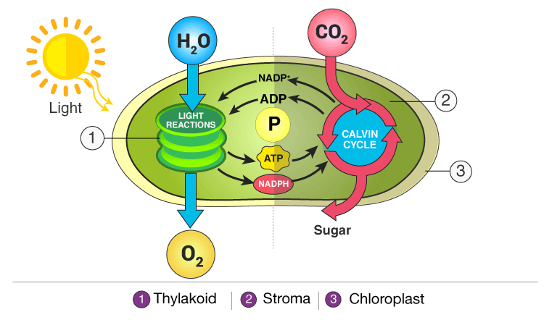
LIGHT & DARK REACTION

Slide 9
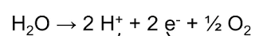
LIGHT REACTION
Occurs in the grana region of the chloroplast.
Chlorophyll present in the chloroplast absorbs visible light and after absorption creates such condition which breaks up water molecule into protons, electrons and molecular oxygen. This is called photolysis.
The electrons and protons released by photolysis are used for the synthesis of ATP and NADPH.

Slide 10
DARK REACTION (LIGHT INDEPENDENT REACTION)
Occurs in the stroma region of the chloroplast.
ATP and NADPH synthesized in the light reaction is used up in the dark phase for the reduction of carbon dioxide to glucose.
The biochemical pathway in the dark phase is known as the Calvin cycle.

Slide 11
PHOTOSYNTHESIS OVERVIEW (3 MAJOR STEPS)
Absorption of solar energy by chlorophyll.
Conversion of light energy into chemical energy and splitting up of water into oxygen and hydrogen.
Reduction of carbon dioxide to carbohydrate by utilizing chemical energy.

Slide 12
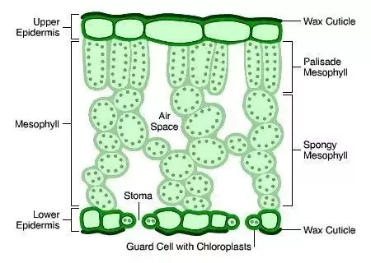
SITE OF PHOTOSYNTHESIS: CHLOROPLAST
Chloroplasts are the site of photosynthesis as they contain chlorophyll pigment.
Chloroplasts occur mostly in the mesophyll cells of the leaves and young stems.

Slide 13
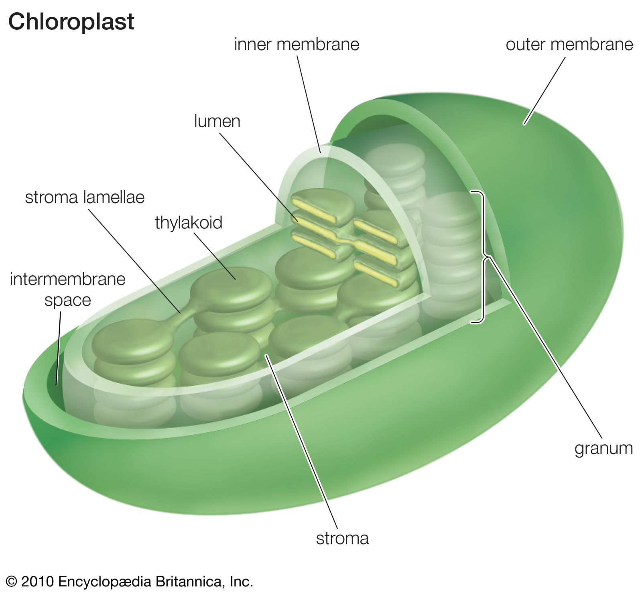
STRUCTURE OF CHLOROPLAST

Slide 14
HOW DO DESERT PLANTS TAKE UP CARBON DIOXIDE?
Certain desert plants photosynthesizes during the day but take up carbon dioxide at night.
At night the carbon dioxide is converted into an intermediate form (malic acid) and stored in the plant cell.
During the day this intermediate form gets reconverted into carbon dioxide and photosynthesis takes place.
In these plants stomata remains shut during the day to reduce transpiration.
This pathway was first of all discovered in the plant family Crassulaceae.
E.g.- Pineapple, orchids, cacti etc.

Slide 15
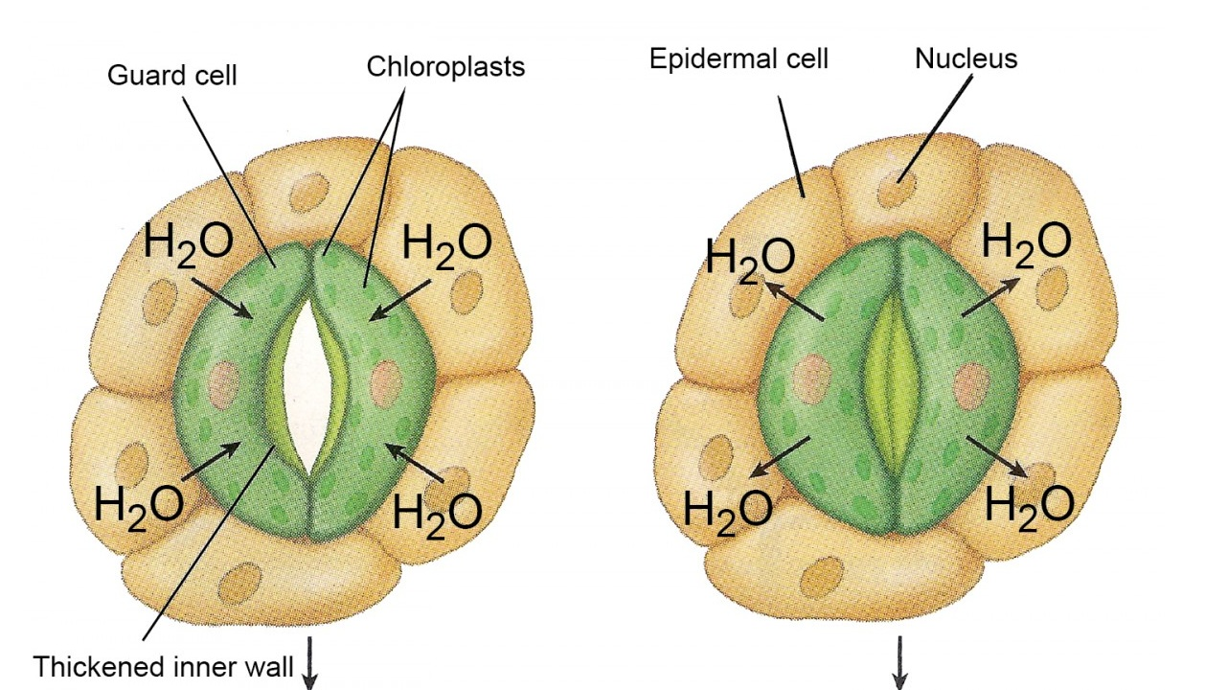
OPENING AND CLOSING OF STOMATA
Stomata are minute pores found in the epidermis of leaves, stems etc.
There are 2 kidney shaped guard cells which bound the minute elliptical pore in stoma.
Guard cells are modified epidermal cells.
The wall of guard cell facing the pore is thick while the outer wall is thin, elastic and semi-permeable.
The guard cells are filled with chloroplast.
The opening and closing of stomata depends on the turgidity of the guard cells.
Due to endosmosis, an increase in turgor pressure of guard cells take place which results in stretching and bulging out of the outer thin walls. This results in pulling of the inner thick walls and thereby opening the stomatal pore.
When the turgor pressure decreases due to exosmosis, the thinner walls sag resulting in thicker walls moving closer and finally closing the stoma.

Slide 16
HOW DO PLANTS OBTAIN WATER FOR PHOTOSYNTHESIS?
The water necessitates by the plants for photosynthesis is absorbed by the root of the plants from the soil through the process of osmosis.
The water absorbed by the roots of the plants is conveyed upward through the xylem vessels to the leaves where it reaches the photosynthetic cells.
The plants also need other raw materials such as nitrogen, phosphorus, iron, and magnesium, etc., for building their body.
The plants take these materials from the soil.
Nitrogen is an essential element used by the plants to make proteins and another compound.

Slide 17
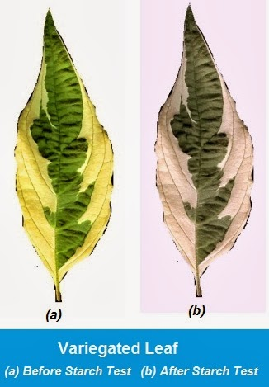
ACTIVITY 6.1 (STARCH TEST)
Take a potted plant with variegated leaves – for example, money plant or crotons.
Keep the plant in a dark room for three days so that all the starch gets used up.
Now keep the plant in sunlight for about six hours.
Pluck a leaf from the plant. Mark the green areas in it and trace them on a sheet of paper.
Dip the leaf in boiling water for a few minutes.
After this, immerse it in a test tube containing alcohol.
Carefully place the above test tube in a water-bath and heat till the alcohol begins to boil.
Now dip the leaf in a dilute solution of iodine for a few minutes.
Take out the leaf and rinse off the iodine solution.
Observe the colour of the leaf and compare this with the tracing of the leaf done in the beginning .

Slide 18
WHY DO WE DIP THE LEAF IN BOILING WATER BEFORE BOILING IT IN ALCOHOL?
To stop any further chemical reaction in the cells of the leaf.
To disrupt the cell membrane and soften the cuticle and cell wall.
WHAT WILL BE THE FINAL OBSERVATION OF THE EXPERIMENT AFTER RINSING WITH IODINE SOLUTION?
The areas of the leaf which were initially green before treatment with alcohol, turned blue-black thereby showing presence of starch.
WHAT IS THE PURPOSE OF USING ALCOHOL IN THE ABOVE EXPERIMENT?
Acts as a bleaching agent (dissolves chlorophyll)
WHAT CAN WE CONCLUDE FROM THE EXPERIMENT?
Chlorophyll is necessary for photosynthesis.

Slide 19
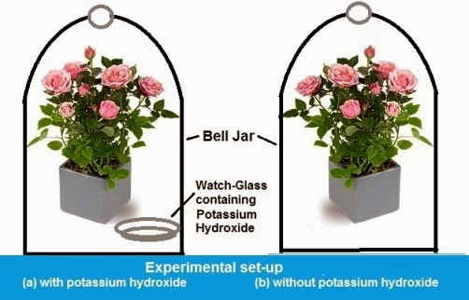
ACTIVITY 6.2
Take two healthy potted plants which are nearly the same size.
Keep them in a dark room for three days.
Now place each plant on separate glass plates. Place a watch-glass containing potassium hydroxide by the side of one of the plants. The potassium hydroxide is used to absorb carbon dioxide.
Cover both plants with separate bell-jars.
Use Vaseline to seal the bottom of the jars to the glass plates so that the set-up is air-tight.
Keep the plants in sunlight for about two hours.
Pluck a leaf from each plant and check for the presence of starch as in the above activity.

Slide 20
DO BOTH THE LEAVES SHOW THE PRESENCE OF THE SAME AMOUNT OF STARCH?
No, both the leaves do not show the presence of the same amount of starch, because in photosynthesis starch is produced using sun light, chlorophyll and CO₂. In first set up availability of CO₂ will be less for making starch by the plant leaves, as potassium hydroxide (KOH ) absorb the CO₂. In second plant setup, the leaves will have more amount of starch.
WHAT CAN YOU CONCLUDE FROM THIS ACTIVITY?
From this activity, we can conclude that amount of Carbon Dioxide (CO₂) , essentially affects the process and outcome of photosynthesis.

